Slide 1
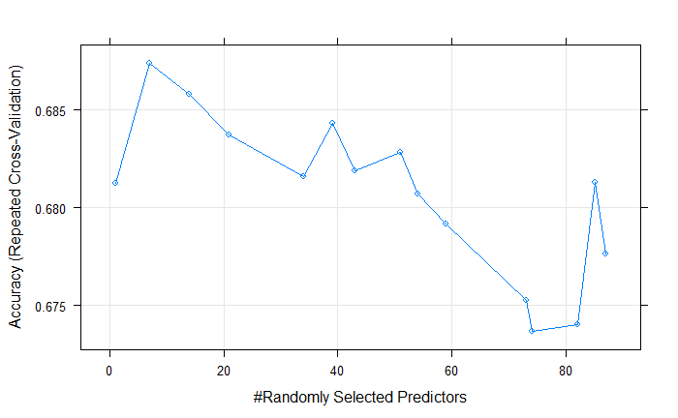
92 LIWC features/word categories
Created with dictionary
Example: pronouns (I, them, itself); positive emotions (love, nice, sweet)
Percentages: number of words belong to category/total word count
Note: People wrote more when using 1p (vs. 3p), p < .001
Random Forest algorithm
Randomly selected features to use as information to predict perspective (optimal = 7 features)
Allow us to identify important features for prediction
Algorithm validation: 66% accuracy (greater than chance, p <.001)

Slide 2
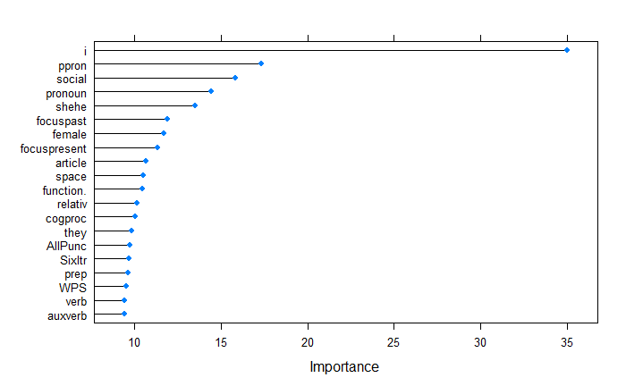
Category | Examples
i (1st person singular) | I, me, mine
ppron (personal pronouns) | I, them, her
social (social processes) | mate, talk, they
shehe (3rd person singular) | she, her, him
focuspast | ago, did, talked
female | girl, her, mom
focuspresent | today, is, now
article | a, an, the
space | down, in, thin
function (total function words) | it, to, no, very
relativ (relativity) | area, bend, exit
cogproc (cognitive processes) | cause, know, ought
they (3rd person plural) | they, their, they’d
AllPunc (all punctuation)
Sixltr (Words>6 letters)
prep (prepositions) | to, with, above
WPS (Words/sentence)
verb (common verbs) | eat, come, carry
auxverb (auxiliary verbs) | am, will, have

Slide 3
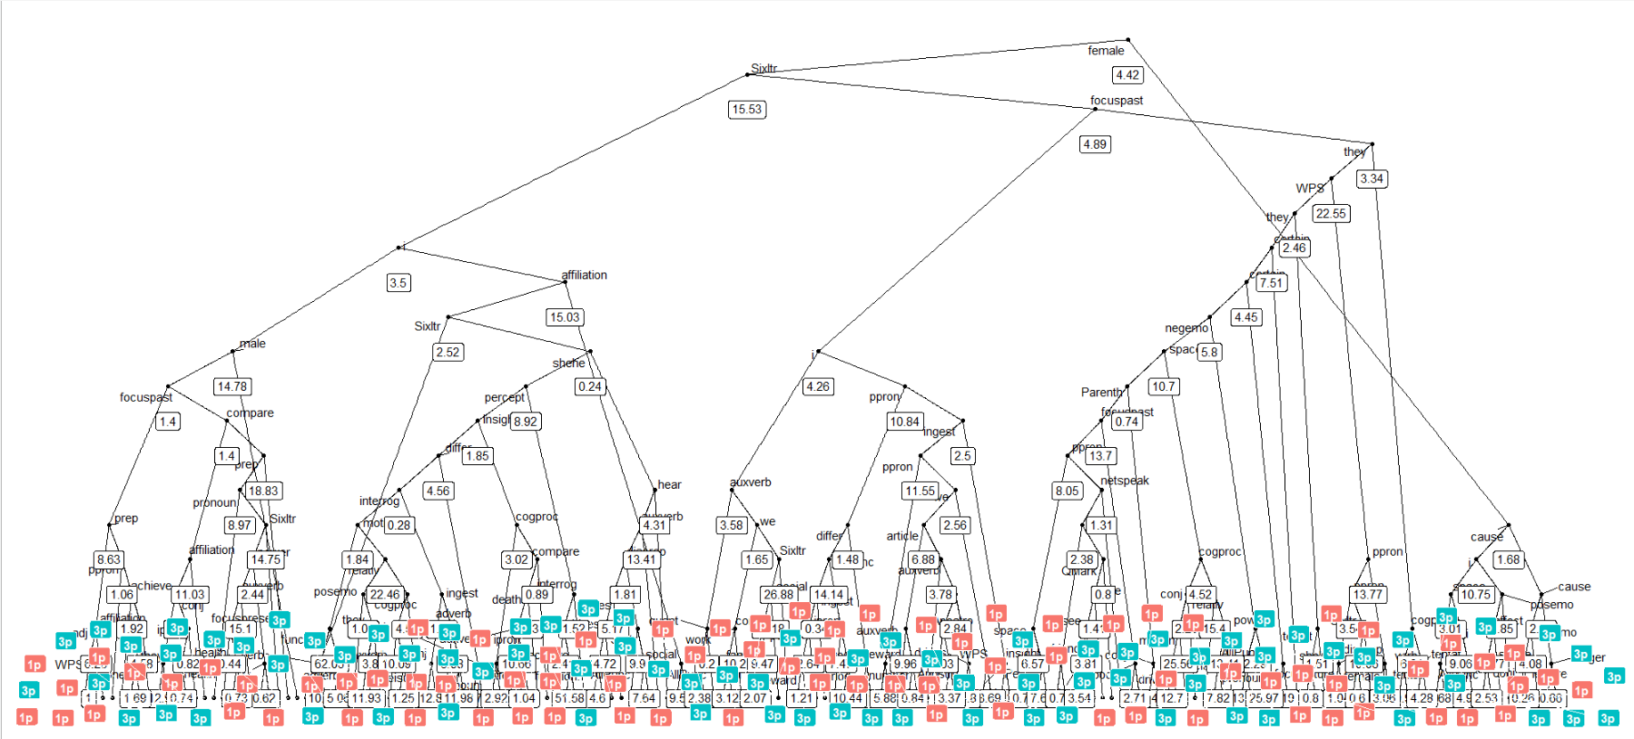

Slide 4
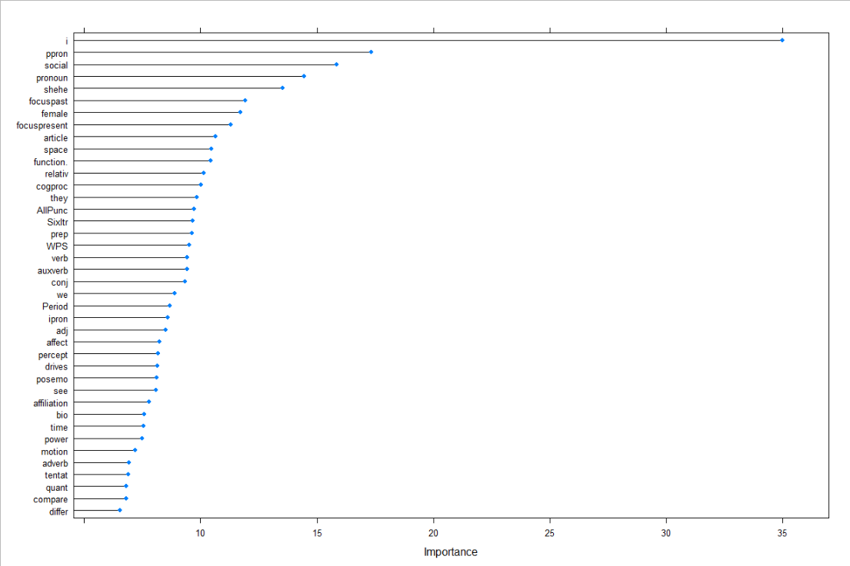

Slide 5
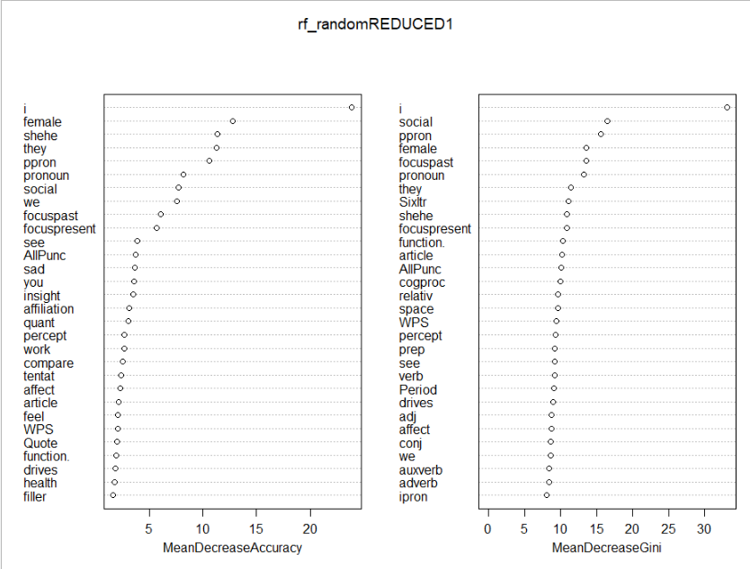
Notes:
"Global" variable importance is the mean decrease of accuracy over all out-of-bag cross validated predictions, when a given variable is permuted after training, but before prediction.
GINI importance measures the average gain of purity by splits of a given variable. If the variable is useful, it tends to split mixed labeled nodes into pure single class nodes.

